Slide 1


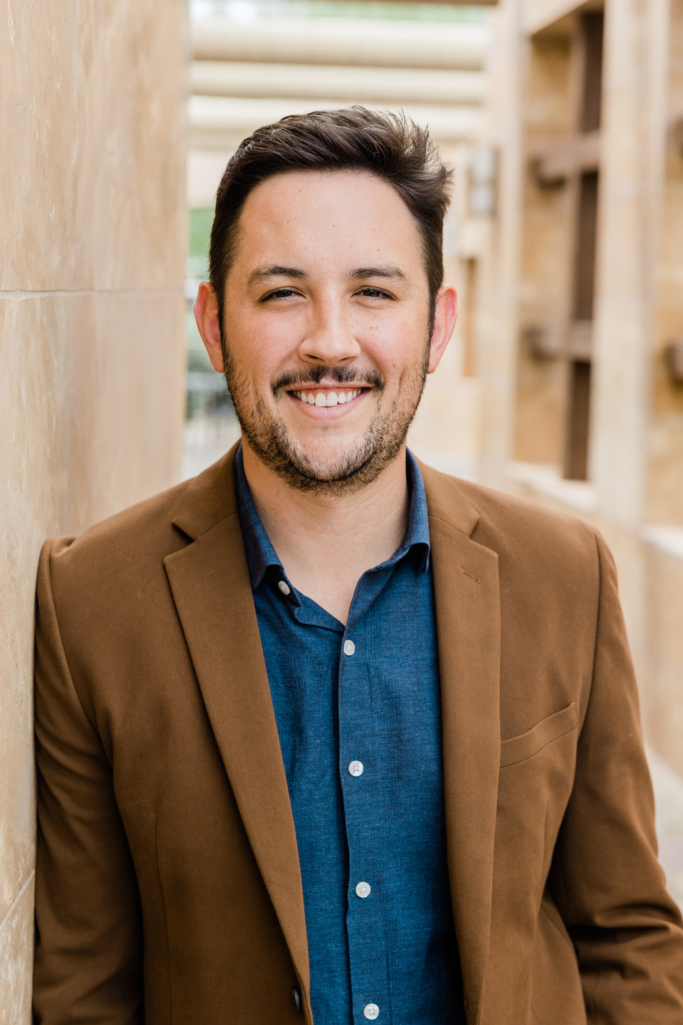




Webinar
Salford & Co.
Digital
Marketing
Expert
Empowering You with Digital Expertise
28 January, 2025
At 09.00 AM
Speaker :
JOIN NOW
Aaron Loeb
@reallygreatsite
+123-456-7890
www.reallygreatsite.com

